Slide 1



A Hands-on Introduction to Physics-Informed Neural Networks (PINN) Integrating Physical Laws into Deep Learning
CIROH Developers Conference 2024
Abdolmehdi Behroozi
PhD Candidate
Civil and Environmental Engineering Penn State University
amb10399@psu.edu
behroozi.fx@gmail.com

Slide 2

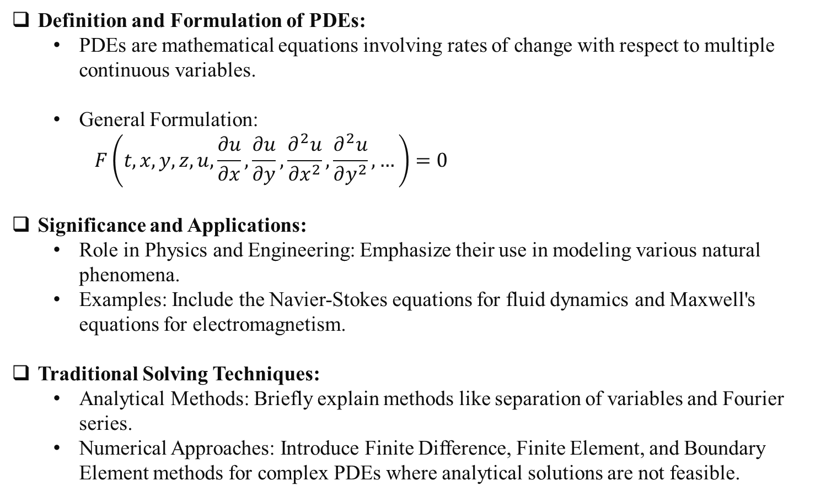
Introduction to Partial Differential Equations (PDEs)
Definition and Formulation of PDEs:
PDEs are mathematical equations involving rates of change with respect to multiple continuous variables.
General Formulation:
$$F\left(t, x,y,z, u,\frac{∂u}{∂x},\frac{∂u}{∂y},\frac{∂^{2}u}{∂x^{2}},\frac{∂^{2}u}{∂y^{2}},…\right)=0$$
Significance and Applications:
Role in Physics and Engineering: Emphasize their use in modeling various natural phenomena.
Examples: Include the Navier-Stokes equations for fluid dynamics and Maxwell's equations for electromagnetism.
Traditional Solving Techniques:
Analytical Methods: Briefly explain methods like separation of variables and Fourier series.
Numerical Approaches: Introduce Finite Difference, Finite Element, and Boundary Element methods for complex PDEs where analytical solutions are not feasible.

Slide 3

Challenges with Traditional PDE Solving Methods
High computational cost for complex equations.
Difficulty with irregular shapes and boundaries.
Time-consuming mesh generation for finite elements.
Problems with scaling to large or detailed systems.
Numerical instability, especially with stiff PDEs.
Not quite appropriate for inverse problems.

Slide 4
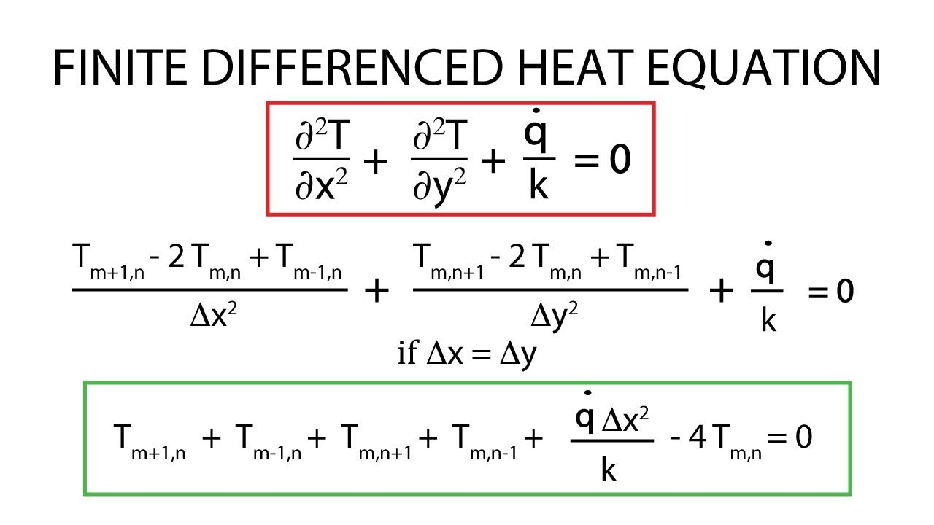
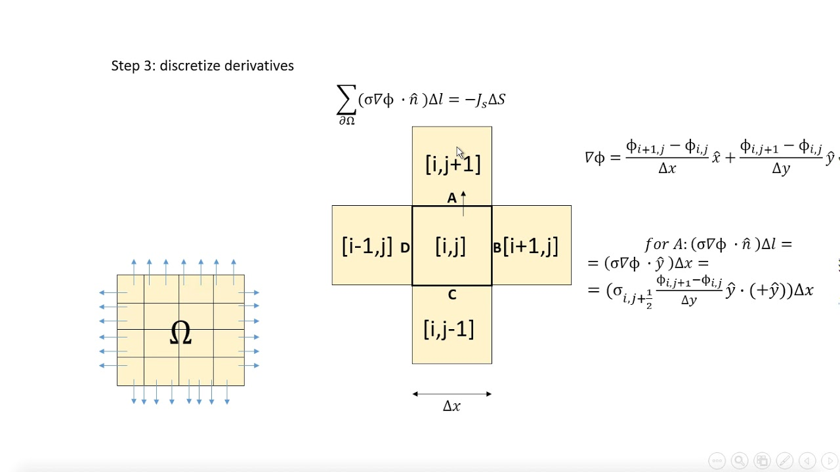
What we really need to solve a PDE?

Slide 5
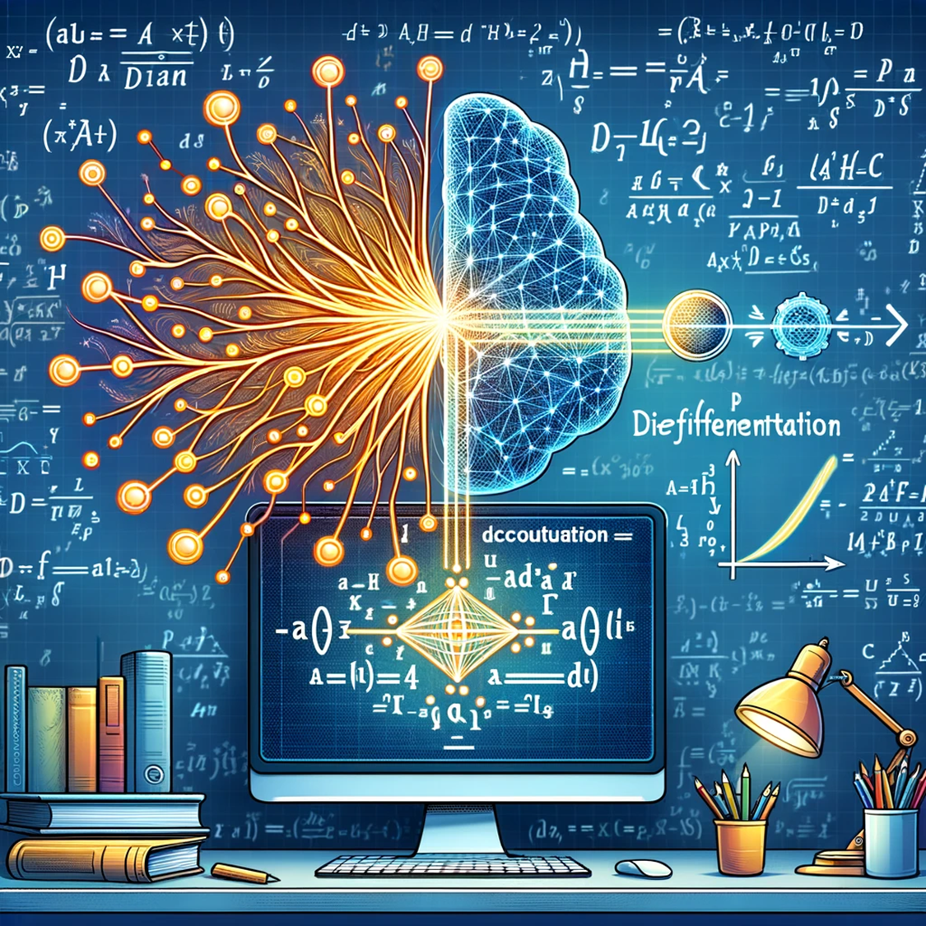
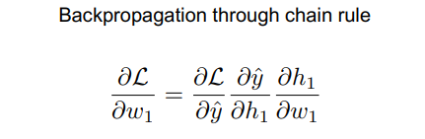
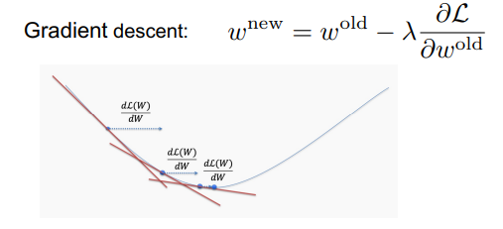
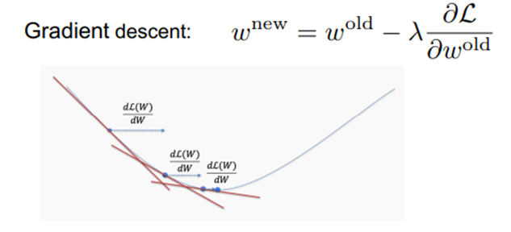
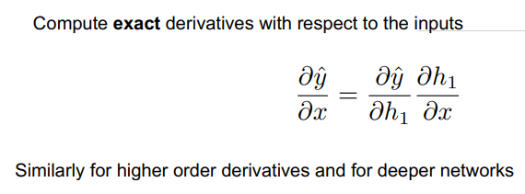
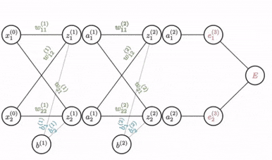
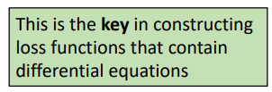
Auto-differentiation and back-propagation: A valuable tool

Slide 6
Neural Networks: A New Frontier for PDEs
Neural Network Recap:
Adaptive learning from complex datasets, mastering pattern recognition.
Efficient at function approximation, enhancing predictive modeling.
Automatic Differentiation (AutoDiff):
Essential for training neural networks, a distinctive feature from traditional methods.
Enables precise and fast gradient computations, supporting continuous improvement.
Setting the Stage for PDE Solutions:
AutoDiff aligns with the derivative calculations needed for PDEs.
Introduces the potential for neural networks to provide new strategies for PDE solving.

Slide 7
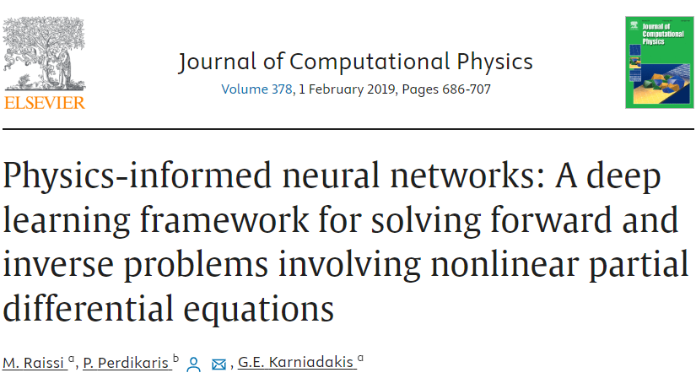
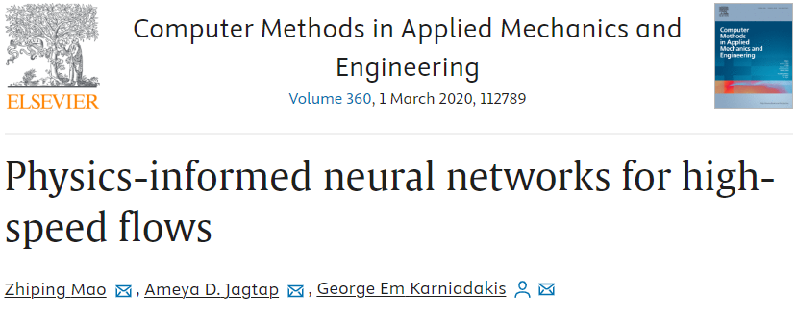
Physics-Informed Neural Networks: Concept and Formulation
What are PINNs?
A smart fusion of neural networks with physical laws.
Utilize known physics to guide the learning process.
How PINNs Work:
Integrate data and physical models into the training.
The network is informed by both observational data and PDEs of the system.
PINN Formulation:
Combines a traditional neural network loss function with a PDE-based regularization term.
Loss function: Data fidelity term + Physical fidelity term.

Slide 8
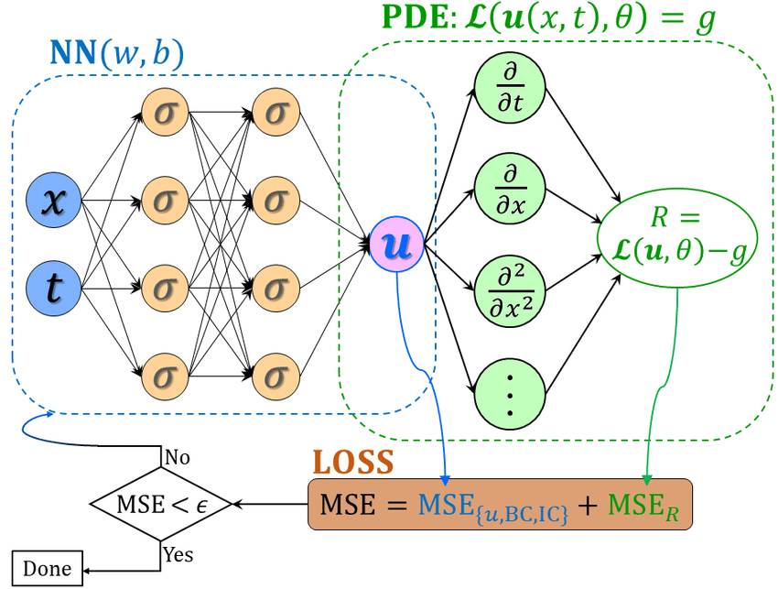
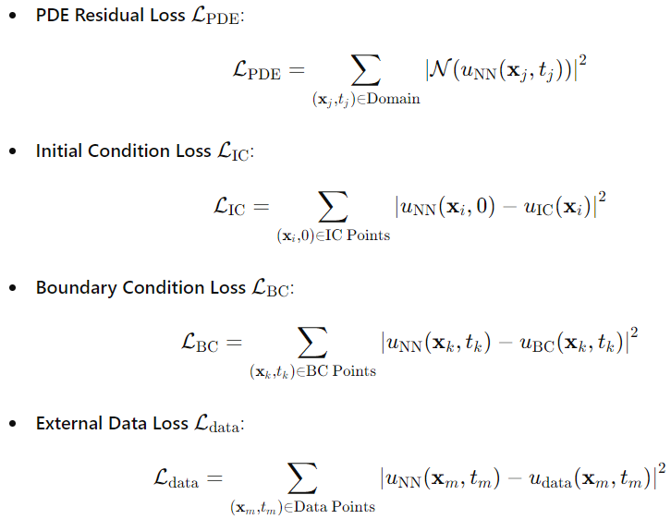
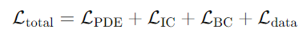
Physics-Informed Neural Network (PINN) Architecture
Thank you AutoDiff !

Slide 9
The Advantages of Physics-Informed Neural Networks
Data Efficiency:
Requires fewer data points by utilizing physical laws.
Strong Interpolation:
Accurate predictions in data-sparse regions due to embedded physics.
Domain Knowledge Integration:
Directly incorporates scientific laws, improving model reliability.
Robustness to Noise:
Better performance with noisy data through physical constraints.
Inverse Problem Solving:
Effective in identifying underlying physical parameters from observable data.

Slide 10
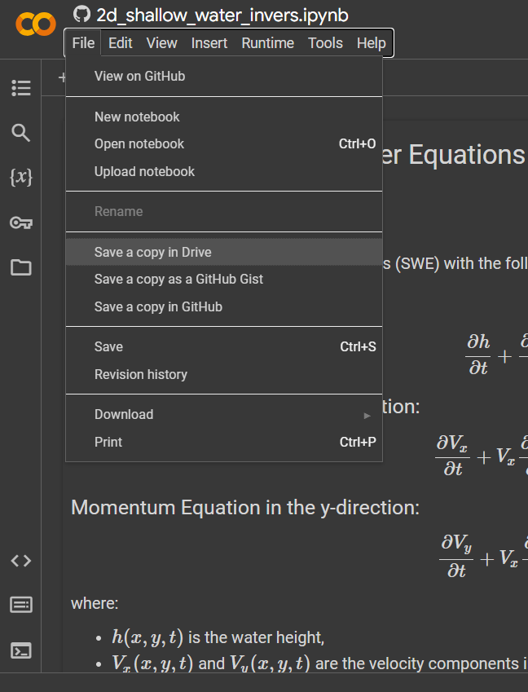


Now let’s run through code tutorials
Tutorial 1 PINN for 1d+t heat equation
Tutorial 2 PINN for 2d+t shallow water equations
Please make a copy on your google drive

Slide 11
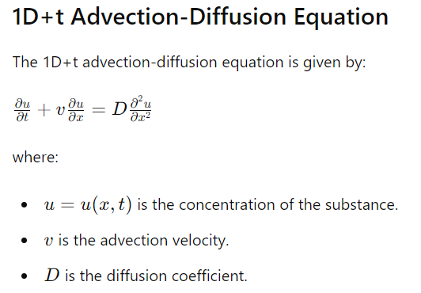
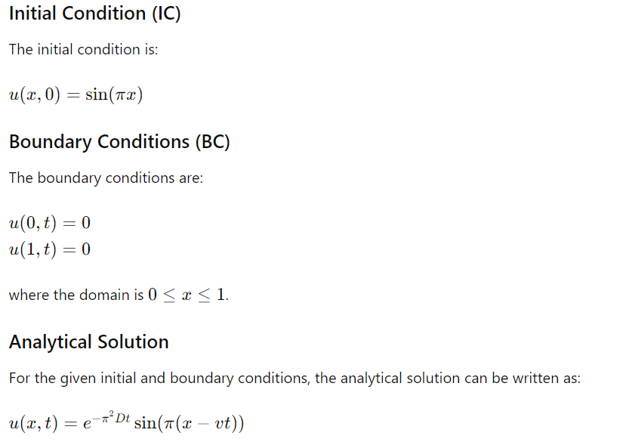
Exercise
Try to change the heat PINN code to solve the following PDE:
v = 0.01
D = 0.01

Slide 12
Drawbacks of PINNs
Training Complexity
Computational Cost
Data Quality Needs
Risk of Overfitting
Black Box Nature
Expertise Requirement
Numerical Stability Issues
…
PINNs are just ANNs under the hood
All the good and bad of ANNs come along with it
We still need to understand the systems we work with.
AI still needs HI …
PINNs can add value, when used sensibly.

Slide 13
Thank you!

